Slide 1

MARKETING MIX (4Ps)
Lecturer: Hana Nguyen Quynh Hoa, PhD
Email: hoa.nguyenquynh@hust.edu.vn

Slide 2
From STP to Marketing-Mix
STP
Marketing – Mix: work together
Who we serve?
→ Segmentation & Targeting
How will we create value for them?
→Differentiation & Positioning
“We are a fast delivery company”
“90% of our deliveries reach customers within 30 minutes”
What we offer?
Product
What customers give up?
→ Price (benefit + value)
How customers obtain it?
Place (Distribution + Time)
How we communicate value?
→ Promotion

Slide 3
The 4Ps: at a glance
PRODUCT
Variety
PRICE
List price
PLACE
Channels
PROMOTION
Advertising
Quality
Design
Features
Brand
Packaging
Services
Discounts
Allowances
Payment terms
Credit terms
Eg: Apple iPhone: premium pricing
Coverage
Locations
Inventory
Logistics
Eg: Apple iPhone: Apple Stores, authorised retailers, telecom operators, online channels
Sales promotion
Personal selling
PR
Digital/direct marketing
Eg: Apple iPhone: Product launches, digital communication, advertising, influencer/media coverage
Eg: Apple iPhone: Premium smartphone: ecosystem, design, camera, iOS, etc.

Slide 4

PRODUCT

Slide 5
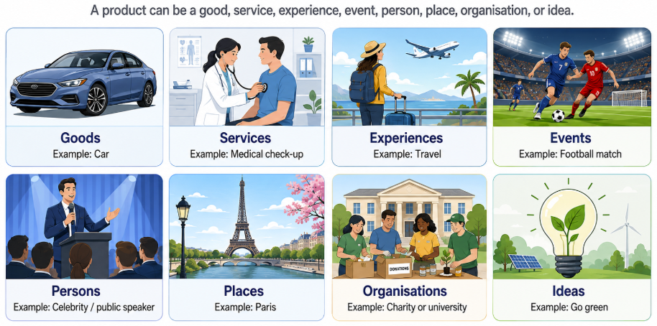
What Is A Product?
A product is anything that can be offered to a market for attention, acquisition, use or consumption that might satisfy a want or need.

Slide 6
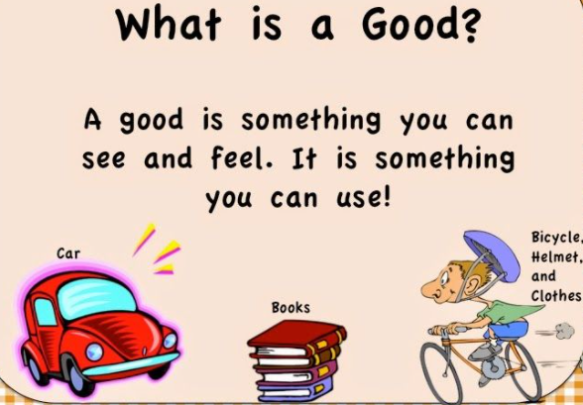
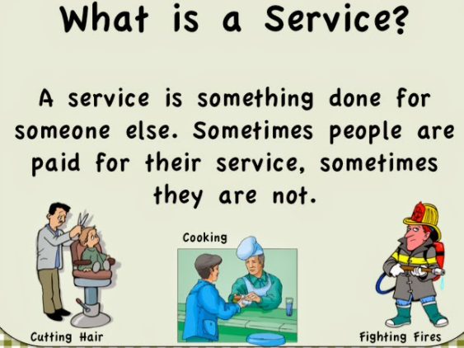
Product: Goods vs. Services
A product is anything that can attract market attention and be consumed, purchased, or exchanged to satisfy consumers’ needs and wants.
A service is a type of product whose value to consumers is determined primarily by the benefits it provides rather than by physical ownership.

Slide 7
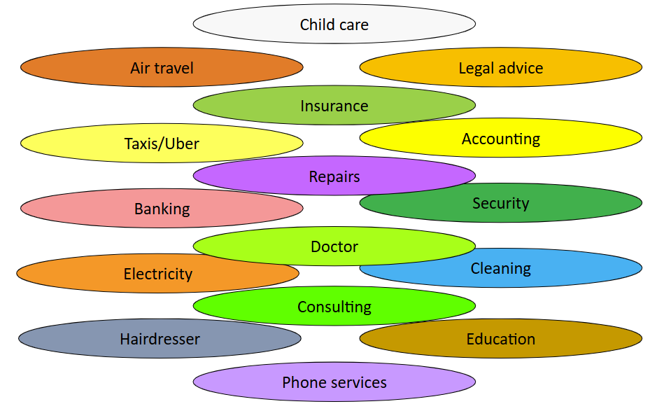
Service characteristics
Intangibility
Cannot be seen, touched, or physically examined before purchase
Customers often have to trust the provider
Cannot usually be “tested” in advance
Inseparability
Production and consumption often occur at the same time
The service provider and customer may both be part of the service experience
Variability
Service quality can vary
It may depend on who provides the service, when, where, and how
Perishability
Services cannot be stored or inventoried for later use
Production and consumption must therefore be coordinated in the right sequence and at the right time

Slide 8
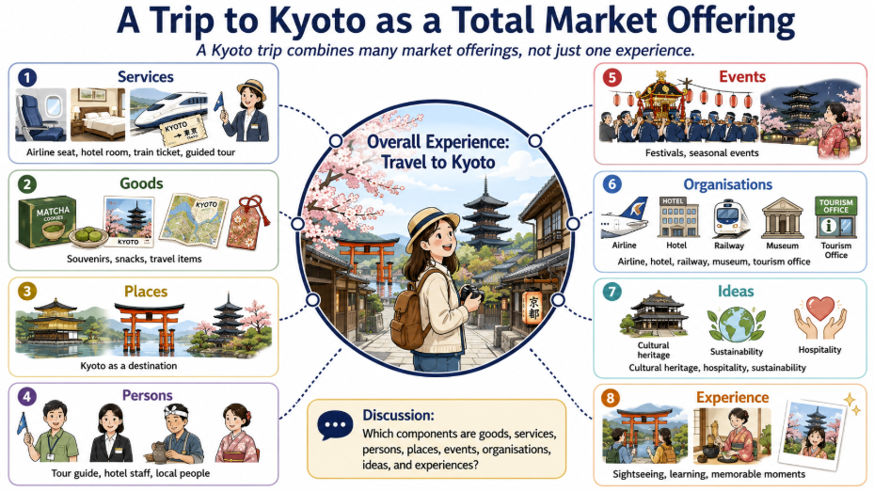

Slide 9
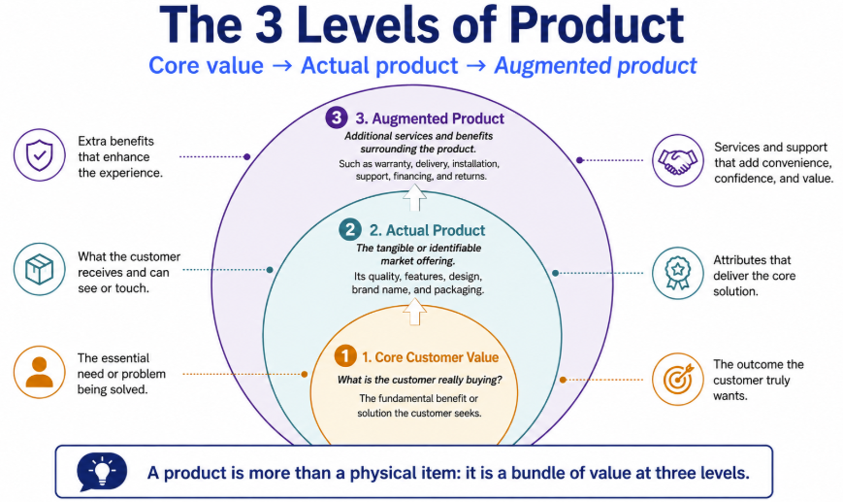
THREE LEVELS OF PRODUCT
1. Core Customer Value
What is the customer really buying?
2. Actual Product
The tangible or identifiable market offering.
Quality level
Features
Design
Brand name
Packaging
3. Augmented Product
Additional services and benefits surrounding the product
Warranty, Delivery, Installation, Customer support, Financing, Returns, App/software support, Loyalty programmes

Slide 10
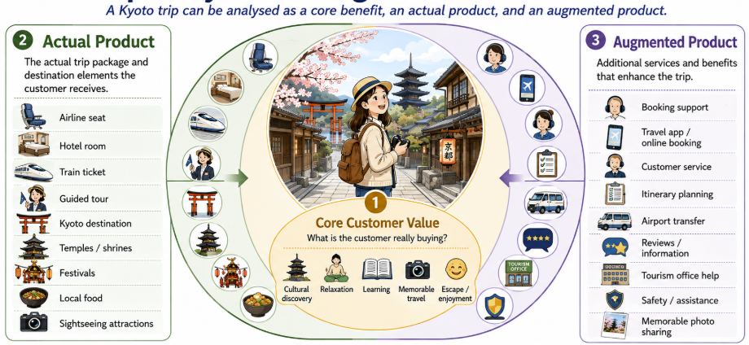

Slide 11
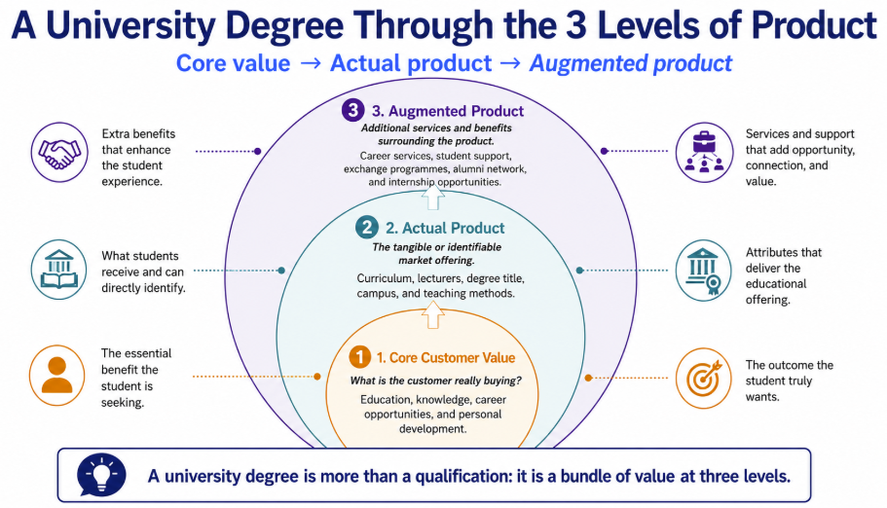
Question:
Analyse the 3 levels of a university degree
Which level creates the greatest differentiation between universities? For example: A Business Administration program at HUST and at NEU
Hints: Differentiation comes from how the programme is designed and what the additional value is.
Actual level: Curriculum, lecturers, specialisations, teaching approach, university reputation
Augmented level: Internships, industry links, exchange opportunities, alumni network, career support

Slide 12
PRODUCT CLASSIFICATIONS: Consumer vs. Industrial Products
Consumer vs. Industrial Products: B2C and B2B marketing
Consumer Products
Purchased by final consumers for personal consumption.
Convenience products
Shopping products
Specialty products
Unsought products
Industrial Products
Purchased for:
further processing,
producing other products,
or conducting a business.
Eg: A laptop bought by:
Student → consumer product
Company for employees → industrial product

Slide 13
Convenience Products
Products consumers usually buy:
Frequently
Immediately
With minimum comparison and effort
Eg: Bottled water, snacks, toothpaste, basic household items
Marketing implications
Relatively low price
Wide distribution
Easy availability
Mass promotion
Eg: Coca-Cola needs to be available almost everywhere customers might want a drink.

Slide 14
Shopping Products
Consumers compare alternatives based on:
Suitability
Quality
Price
Style
Eg: Furniture, Clothing, Electronics, Hotels, Cars
Marketing implications
Selective distribution
More information
Greater salesperson/customer interaction
Product differentiation becomes important

Slide 15
Specialty Products
Products with: Unique characteristics & Strong brand identification
Customers are willing to make special purchasing effort.
Eg: Ferrari, Rolex, Luxury designer handbags, Certain specialist cameras
Customers often do not compare many substitutes.
Marketing implication: Brand identity and exclusivity matter more than distribution intensity.

Slide 16
Unsought Products
Products consumers:
Do not know about, or
Normally do not think of buying.
Eg.: Funeral services, Certain insurance products, Emergency medical products
Marketing implication: They often require:
Strong awareness building
Personal selling
Education
Persuasive communication

Slide 17
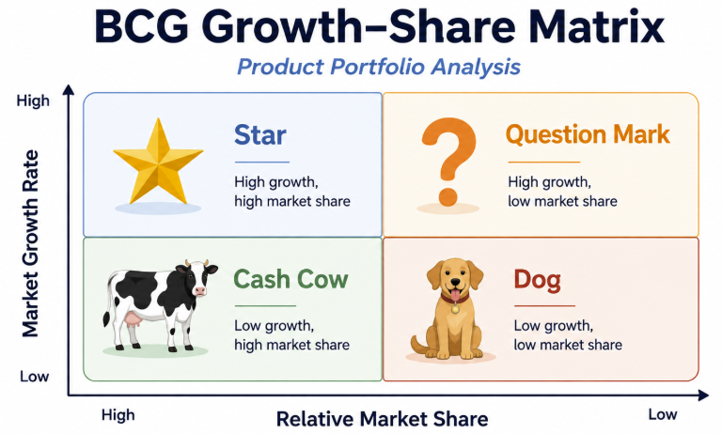

Slide 18
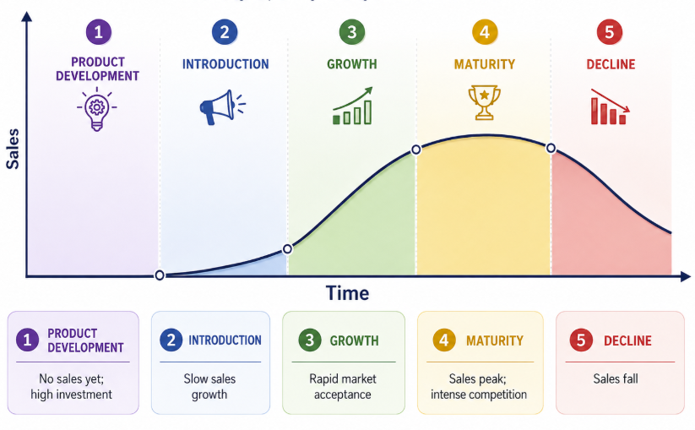
Product Life Cycle (PLC)
Development: no sales yet; investment costs are high
Introduction: sales grow slowly; profits are usually low or negative
Growth: sales rise rapidly; profits increase
Maturity: sales growth slows; competition becomes intense
Decline: sales and profits fall
→ Companies need new products because:
Customer needs change
Technology changes
Competitors innovate
Existing products decline
New market opportunities emerge

Slide 19

PRODUCT DECISION
Product Quality
Product Features
Product Design

Slide 20
Product Quality
Quality Level: The level of performance appropriate for the target market.
Quality Consistency: Delivering the expected level of performance consistently.
Higher quality does not always mean “the best possible quality.”
Eg: A budget hotel does not need golden bathrooms, but customers still expect:
cleanliness,
safety,
and consistency.

Slide 21
Product Features
A basic product can be offered with different features → Features can help:
Differentiate a product
Target different segments
Support different price levels
Increase customer value
Eg: Cars
Basic model:
Standard engine
Manual controls
Higher version:
Advanced safety
Larger screen
Premium audio
Driver assistance
Leather interior

Slide 22
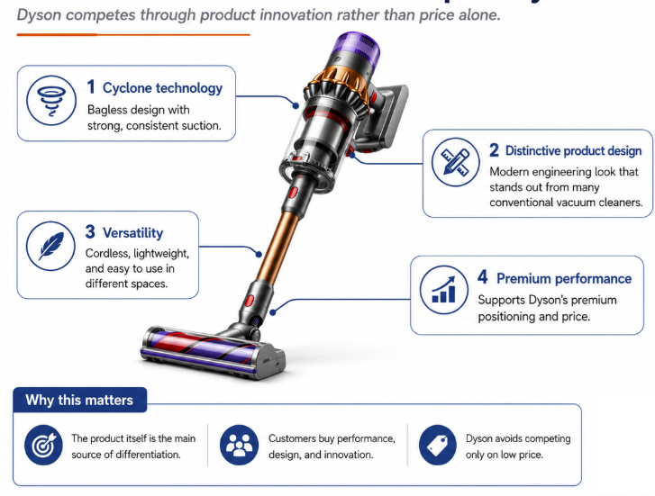
Product Design and Style
Style describes the appearance of a product.
Design contributes to both appearance and usefulness/performance.
Good design begins with observing customer needs, not only making a product look attractive

Slide 23
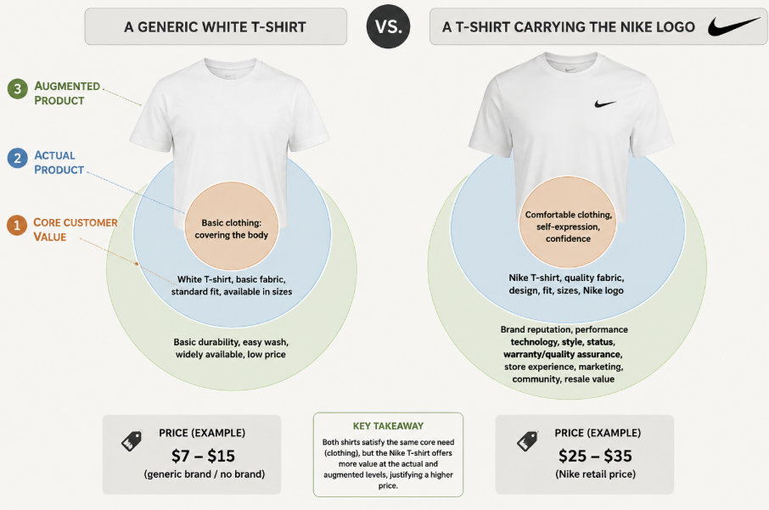
BRANDING
A brand is more than a name or logo. It represents consumers':
Perceptions
Experiences
Expectations
Associations
Relationships with the
Product
Brands can help
Identify products
Reduce search effort
Reduce perceived risk
Signal expected quality
Express identity
Build trust

Slide 24
BRAND NAME
A strong brand name should ideally be:
Memorable: Nike, Apple, Grab
Distinctive: Sunkiss, Google, Qantas
Easy to pronounce: Heineken vs. Carlsberg
Appropriate to the product: Cocoon, Sunsilk, Head & Shoulder
Extendable: Vinhomes, VinMec, VinFast, Vinmart, VinEdu
Legally protectable: Kodak, Bvlgari
Suitable across markets
International challenge: Names can carry different:
meanings,
pronunciation,
associations
across countries.

Slide 25
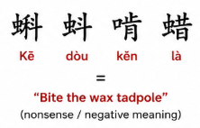
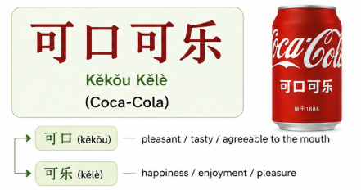
Coca-Cola in China: Brand Name Localisation
When Coca-Cola entered China in the late 1920s, some local sellers created phonetic Chinese renderings of “Coca-Cola” before the company had established an official Chinese brand name. Some combinations of characters sounded roughly like Coca-Cola but produced absurd meanings such as “bite the wax tadpole” or similar nonsense.
The Coca-Cola Company later selected 可口可乐 (Kěkǒu Kělè), which preserves a reasonably similar sound while carrying positive associations roughly along the lines of “tasty/pleasant to the mouth” and “happiness.”

Slide 26
Chevrolet Nova
When Chevrolet introduced their car Nova to Spanish-speaking markets, people later joked that the name sounded like the Spanish phrase “no va” — “it doesn’t go.” This became a famous marketing story: imagine trying to sell a car whose name seems to say that it cannot move.

Slide 27
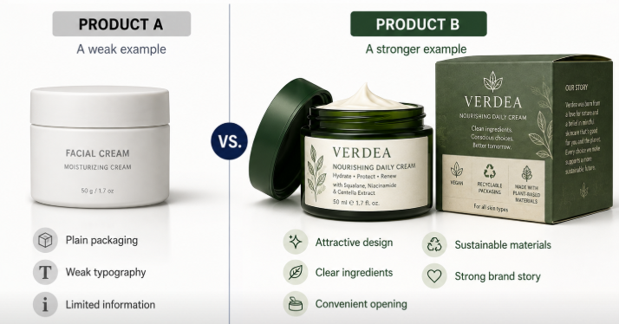
PACKAGING
Packaging: More Than a Container
Packaging traditionally protects the product.
Today it can also:
Attract attention
Communicate positioning
Differentiate brands
Provide convenience
Communicate information
Support brand recognition
Packaging as a Marketing Tool: shapes perceived value before the product is even used

Slide 28
Reduce, Reuse and Recycle Package
Current packaging strategies commonly focus on Reduce, Reuse and Recycle, including lighter packaging, recycled content, refill systems, reusable containers, recyclable mono-materials, and, where appropriate, compostable or bio-based materials.
Less material — smaller, lighter packaging
Recycled materials — recycled paper, glass or plastic
Recyclable design — easier for consumers to sort and recycle
Reusable / refillable packaging — refill pouches, returnable bottles, refill stations
Renewable or bio-based materials — where environmentally appropriate
Minimal unnecessary packaging
Eg: the EU's new Packaging and Packaging Waste Regulation generally began applying on 12 August 2026 and aims to reduce unnecessary packaging, increase reuse, and improve recyclability
In Vietnam, many F&B sellers have shifted from conventional plastic takeaway containers to alternatives such as sugarcane-bagasse boxes, paper packaging, biodegradable bags, and other plant-based materials. Eg: Central Retail Vietnam has piloted food trays and packaging made from biodegradable sugarcane bagasse, and Vietnamese F&B businesses have also adopted eco-friendly takeaway packaging

Slide 29
Labelling
Labels may:
Identify the product
Describe the product
Provide instructions
Communicate ingredients
Provide safety information
Support brand positioning
Meet legal requirements
Eg: Food labels:
Nutrition information
Ingredients
Allergens
Origin
Expiry date

Slide 30

Team work

Slide 31
Questions:
Analyse the 3 levels of your business case study
Which levels can be use to compete on the market?
Any suggestions for the Product decision?

